Slide 1
Istio Service-Mesh
Reference:
https://istio.io/latest/docs/setup/getting-started/

Slide 2
Download Istio
Download Istio Installer Zip.
Unzip the folder and copy it on C:/ Drive
Go Inside the folder home and run the command on linux bash to add IstioCtl client to your path.
$ export PATH=$PWD/bin:$PATH

Slide 3
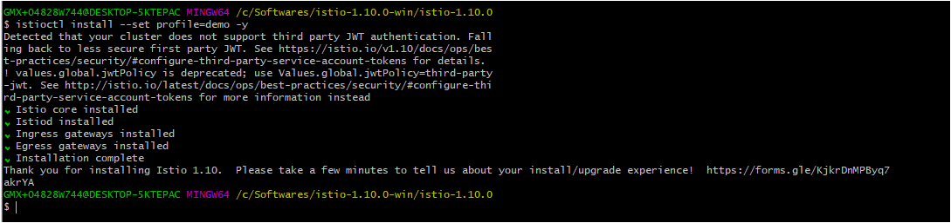
Istio Installation
Run Command
$ istioctl install --set profile=demo -y

Slide 4

Automatically inject Envoy Sidecar proxies to default namespace
Run Command
$ kubectl label namespace default istio-injection=enabled

Slide 5
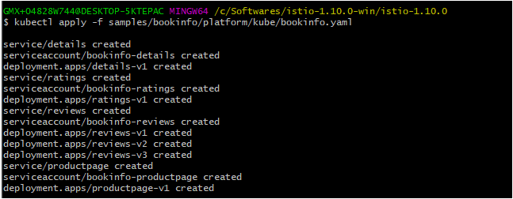
Deploying book-info app
Run Command
$ kubectl apply -f samples/bookinfo/platform/kube/bookinfo.yaml

Slide 6
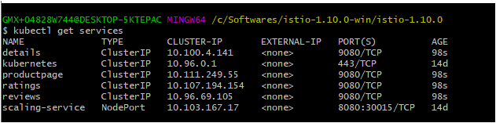
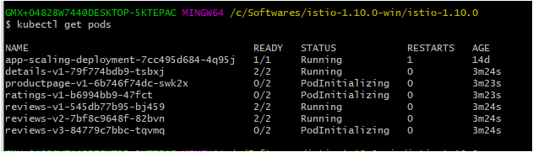
AutomatCheck all services are deployed well ically inject Envoy Sidecar proxies to default namespace
Run Command
$ kubectl get services
$kubectl get pods

Slide 7
Verify everything working correctly or not
Run Command
$ kubectl exec "$(kubectl get pod -l app=ratings -o jsonpath='{.items[0].metadata.name}')" -c ratings -- curl -sS productpage:9080/productpage | grep -o "<title>.*</title>"

Slide 8
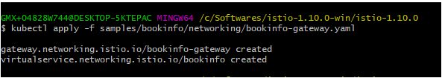
Apply Gateway opening app from outside
$ kubectl apply -f samples/bookinfo/networking/bookinfo-gateway.yaml

Slide 9
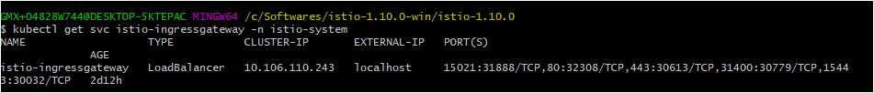
Finding Ingress IP and Port:
$ kubectl get svc istio-ingressgateway -n istio-system

Slide 10

Setting up Environment Variables
export INGRESS_HOST=$(kubectl -n istio-system get service istio-ingressgateway -o jsonpath='{.status.loadBalancer.ingress[0].ip}')
export INGRESS_PORT=$(kubectl -n istio-system get service istio-ingressgateway -o jsonpath='{.spec.ports[?(@.name=="http2")].port}')
export SECURE_INGRESS_PORT=$(kubectl -n istio-system get service istio-ingressgateway -o jsonpath='{.spec.ports[?(@.name=="https")].port}')
echo $SECURE_INGRESS_PORT
echo $INGRESS_HOST
export INGRESS_PORT=$(kubectl -n istio-system get service istio-ingressgateway -o jsonpath='{.spec.ports[?(@.name=="http2")].nodePort}')
export SECURE_INGRESS_PORT=$(kubectl -n istio-system get service istio-ingressgateway -o jsonpath='{.spec.ports[?(@.name=="https")].nodePort}')
echo $INGRESS_HOST
export INGRESS_HOST=$(kubectl -n istio-system get service istio-ingressgateway -o jsonpath='{.status.loadBalancer.ingress[0].hostname}')

Slide 11
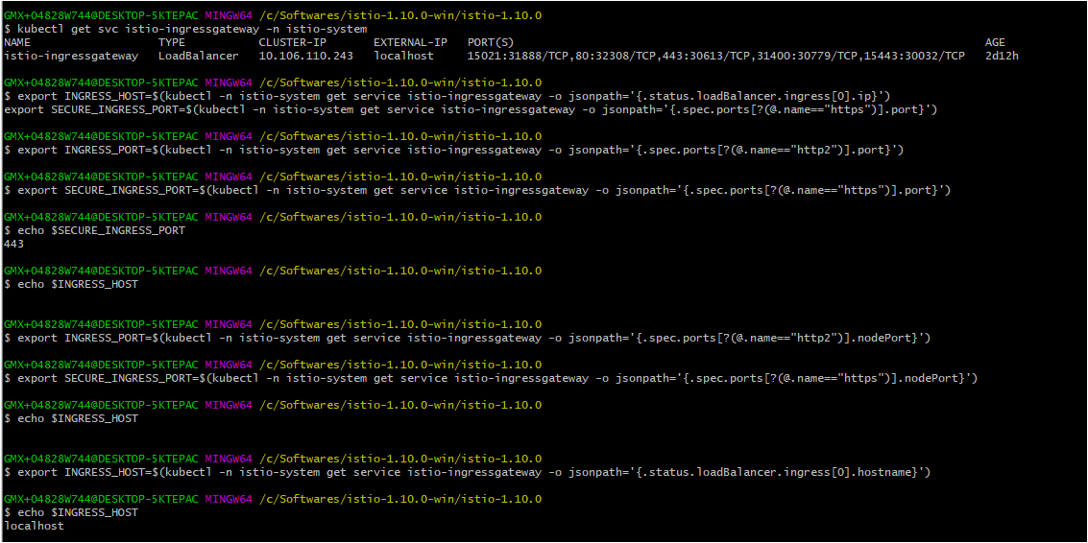

Slide 12
Access the App from Browser (Distributing V1/V2/V3 Apps-Round Robin Method):

Slide 13
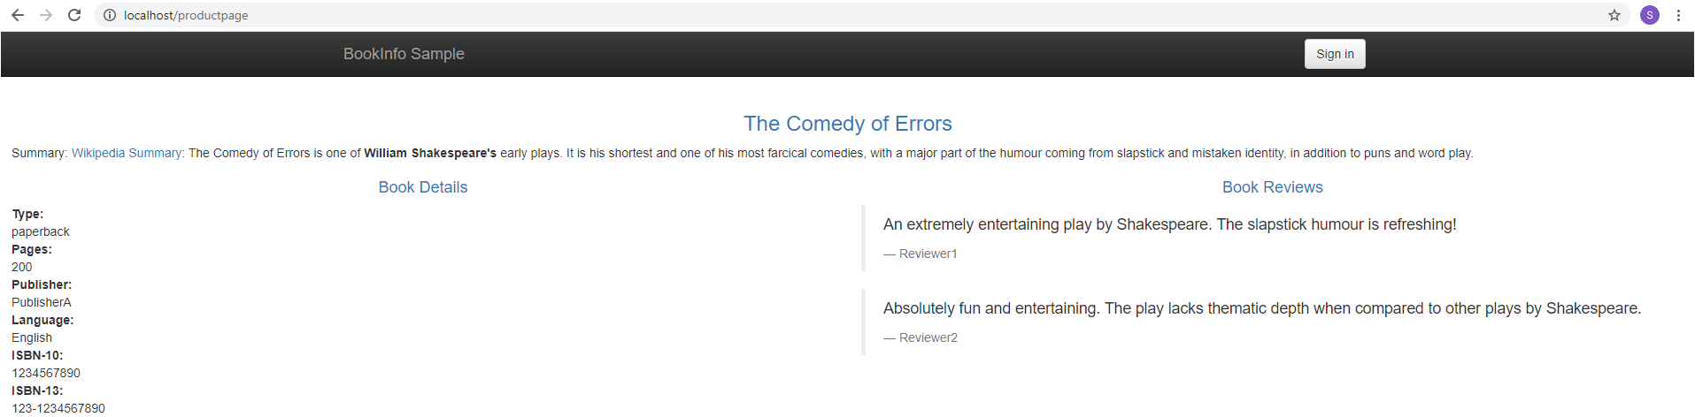
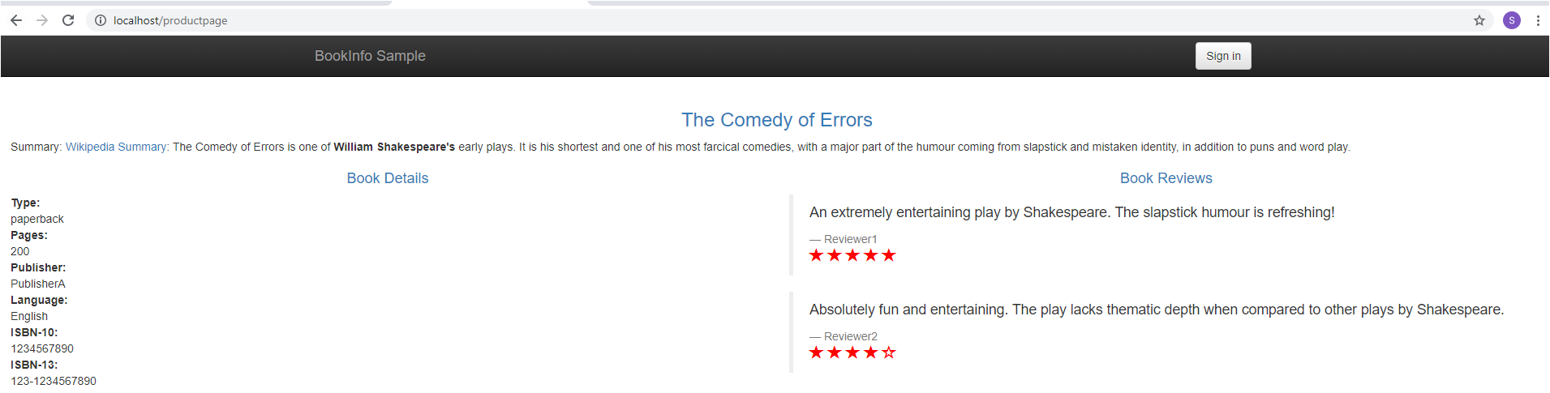
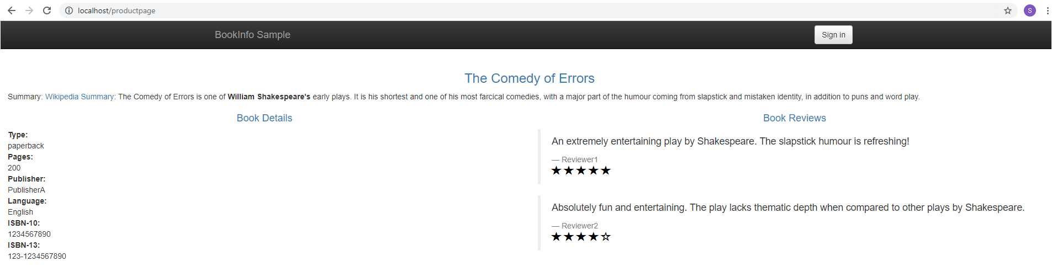

Slide 14
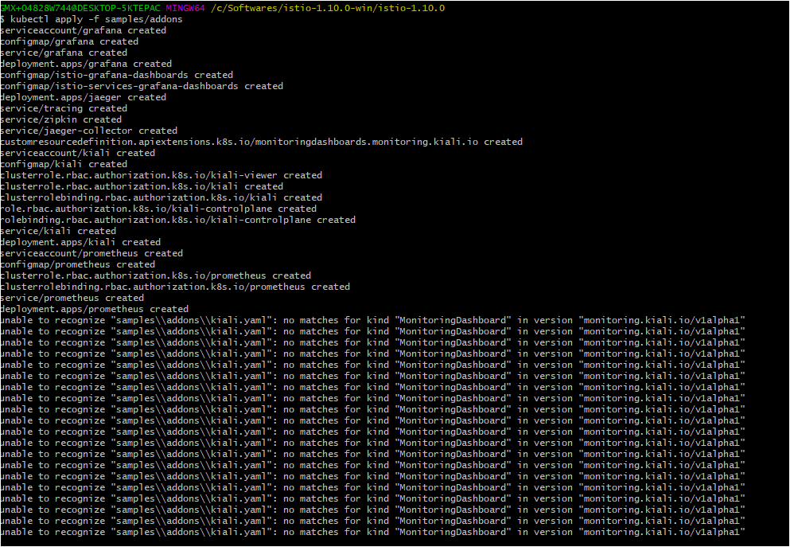
Kiali Dashboard
Install
$ kubectl apply -f samples/addons

Slide 15
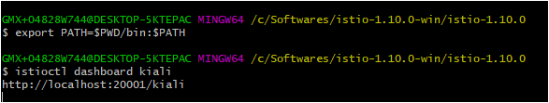
Accessing Kiali Dashboard
$ istioctl dashboard kiali

Slide 16
Kiali Dashboard UI

Slide 17
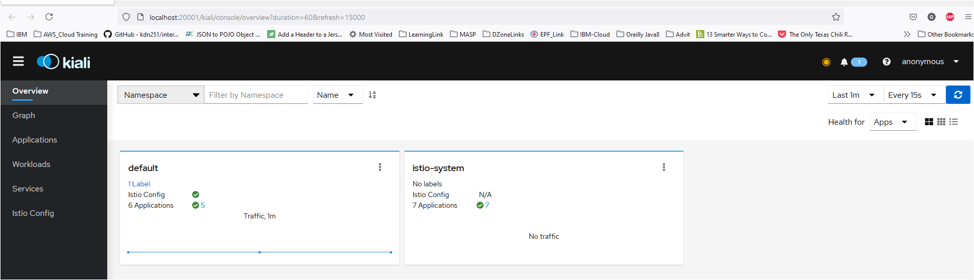

Slide 18
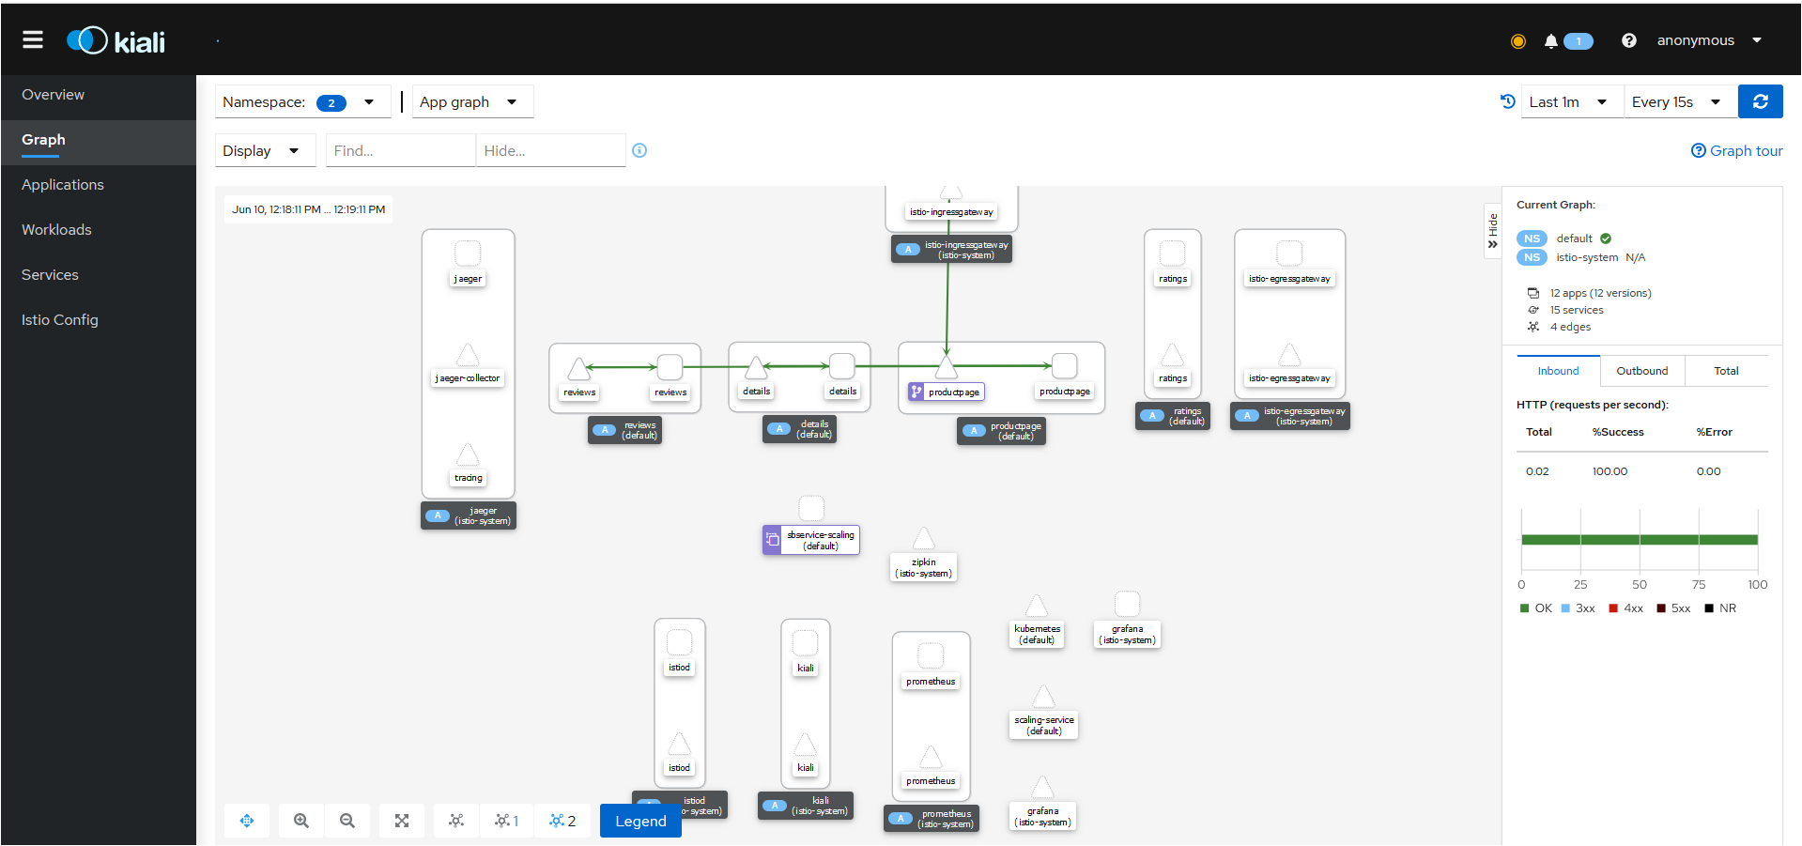

Slide 19
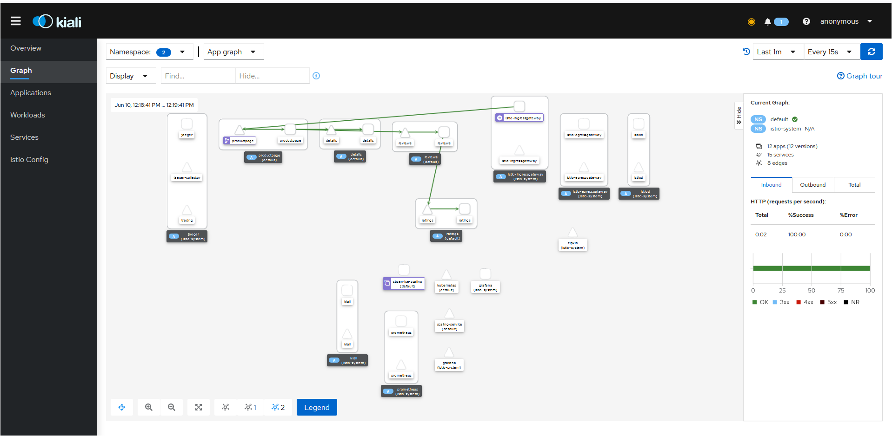

Slide 20
Request Routing

Slide 21
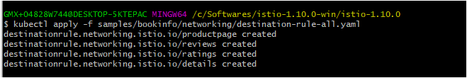
Apply Default Destination Rules
$ kubectl apply -f samples/bookinfo/networking/destination-rule-all.yaml

Slide 22

Apply Virtual Service (All Requests Routes to V1):
$ kubectl apply -f samples/bookinfo/networking/virtual-service-all-v1.yaml

Slide 23
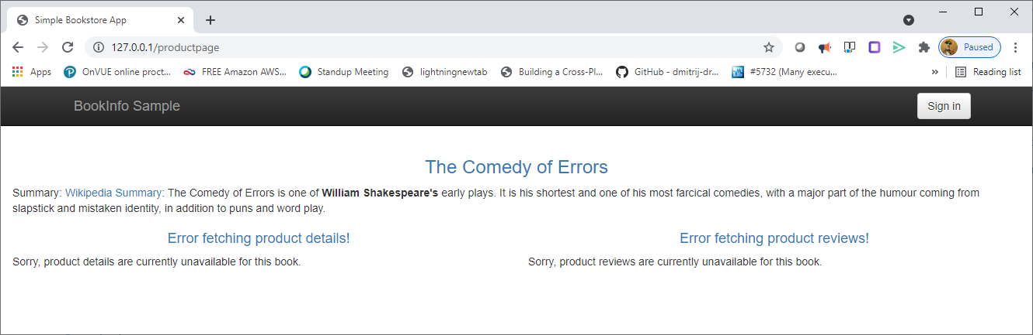
With Multiple Request Same Page Display

Slide 24

Route User Based Identity
$ kubectl apply -f samples/bookinfo/networking/virtual-service-reviews-test-v2.yaml

Slide 25
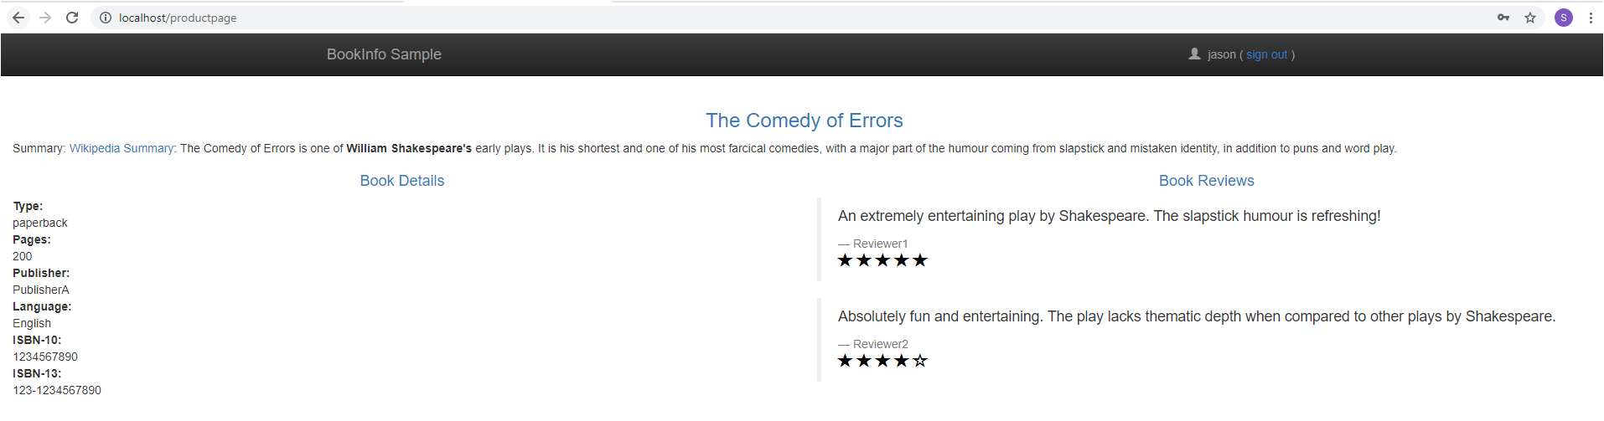
Accessing Page (User:Jason Version-2 Displays)

Slide 26
Accessing Page (Default User. V1 Displays)

Slide 27

Cleanup
$ kubectl delete -f samples/bookinfo/networking/virtual-service-all-v1.yaml

Slide 28

Fault Injection

Slide 29
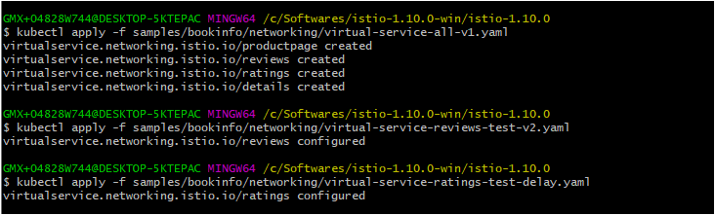
Applying Fault Injection
$ kubectl delete -f samples/bookinfo/networking/virtual-service-all-v1.yaml
kubectl apply -f samples/bookinfo/networking/virtual-service-all-v1.yaml
kubectl apply -f samples/bookinfo/networking/virtual-service-reviews-test-v2.yaml
kubectl apply -f samples/bookinfo/networking/virtual-service-ratings-test-delay.yaml

Slide 30
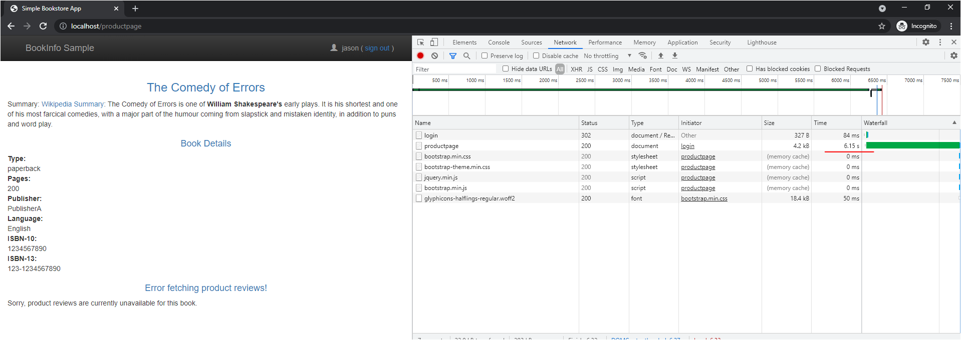
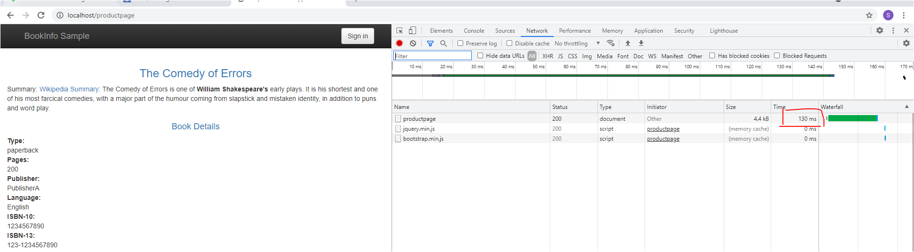

Slide 31

Aborting Injection of HTTP fault
$ kubectl apply -f samples/bookinfo/networking/virtual-service-ratings-test-abort.yaml

Slide 32
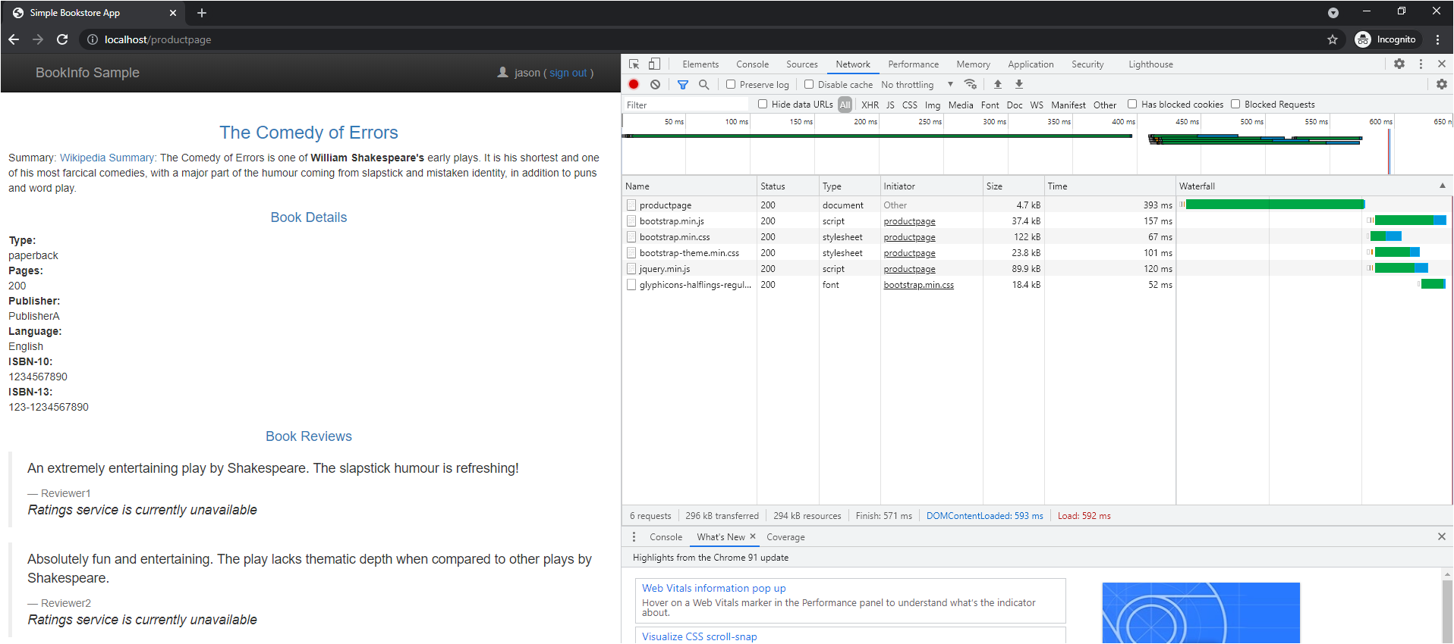
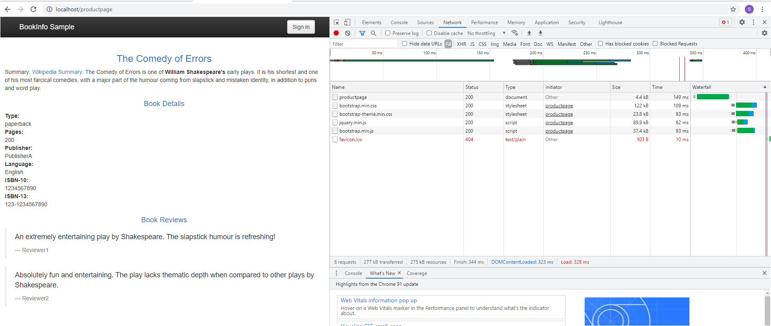

Slide 33
The End

